Slide 1
Policy Support System
Mentor : Pooja Bassin
Name : Manish Reddy Koppula Roll No: IMT2020019
GitHub Link: https://github.com/Manish3693/WSL_PSS.git

Slide 2
Sprint - 1 (11-01-24 to 18-01-24)
A General Understanding of the project, the research papers, the dataset.
Briefly going over the old Github Repo.
Learning the basics of Tableau and going through various Python Visualization libraries for any future usage.

Slide 3
Sprint - 2 (18-01-24 to 25-01-24)
Go through the old code thoroughly to get a good idea for the modifications to make.
Making a new code* by referencing the old code** to make the Impact and Stability for Rice production for intervention in NPK.
Visualizing the Adjacency Graph of the Districts in Karnataka
* new code is the one to be made for the KAG 2016-17 database,
**old code is the one used previously for the IMR_MMR database

Slide 4
Sprint - 3 (25-01-24 to 2-02-24)
Modifying the new code to automate the Impact and Stability Calculation for 1D Stability modelling.
Visualize Impact Vs Stability for 1D Stability modelling
Visualize all the Capability Vectors in different ways and look for inferences.

Slide 5
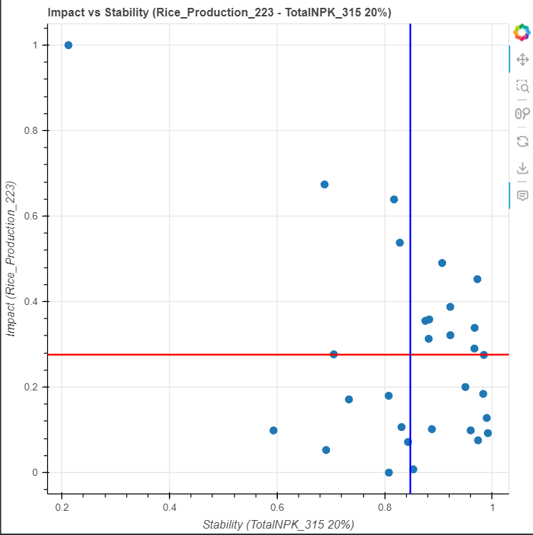

Slide 6
Sprint - 4 (2-02-24 to 9-02-24)
Expand the code from 1-Dimensional to 2-Dimensional.
Get a basic understanding of Multiple Linear Regression.
Improve the Impact vs Stability Graphs done previously.

Slide 7
Major Outcomes
S1
S2
S3
S2
S4
18-01-24
02-02-24
25-01-24
09-02-24
Acquired a Good grasp on the project goals, work done, mathematics involved and the work that we would be doing in the future
Automated Impact and Stability calculations for 1D Stability modeling, visualized their relationship, a very thorough understanding of the math involved.
A thorough understanding of the old code and a New code to measure the impact and stability of rice production through NPK intervention.
Upgraded the code from 1D to 2D, grasped the basics of Multiple Linear Regression, and enhanced the prior Impact vs Stability Graphs for better visualization.

